Slide 1
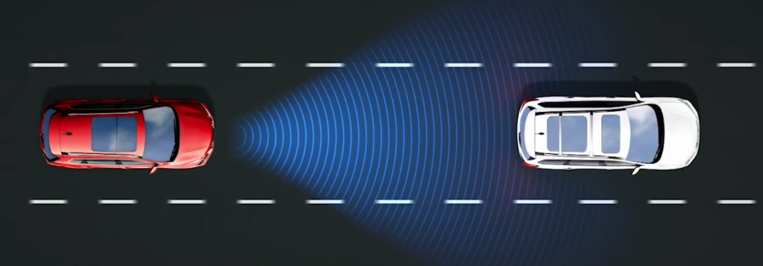
AUTONOMOUS EMERGENCY BRAKING SYSTEM
TEAM – 3
MOHAMED ASHARAF.M
SHIVANI.B
GIRIPRASATH.M.U
SIVARANJANI.P
HARINIVASH.K

Slide 2
WORK PHASES
Requirement phase
Functional requirement
Modeling phase
Simulink
Testing phase
Test plan
Test strategy
Test result
Report generation
System design report
Model advisor report
Strategy

Slide 3
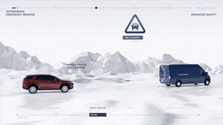
INTRODUCTION
Autonomous Emergency Braking (AEB) is an advanced safety system designed to assist drivers in avoiding or mitigating collisions by automatically applying the brakes when a potential collision is detected.
The primary purpose of our AEB - Measurement of sensor

Slide 4
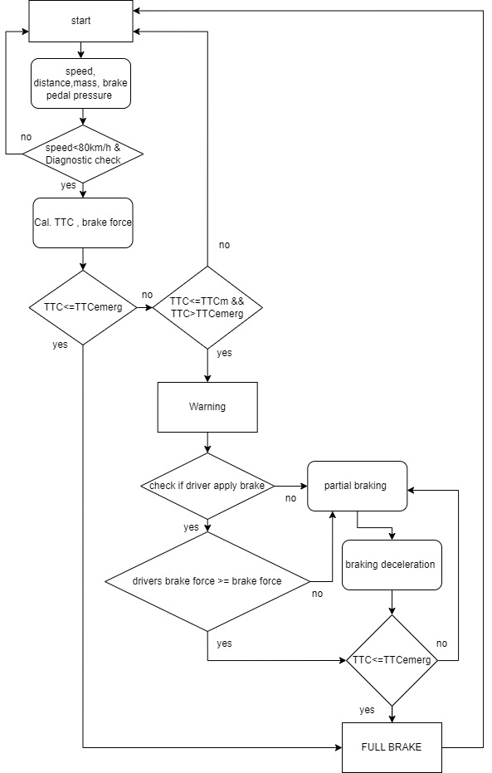
FLOW DIAGRAM

Slide 5
FUNCTIONAL REQUIREMENT
FR1: To get the speed of the ego vehicle and leading vehicle and distance between them.
FR2: Check if the speed of the ego vehicle is less than 80 Km/hr. If the condition is false, then AEB should not be turned on
FR3: If the above condition is true then calculate the time to collision.
FR4: If TTC<TTCemerg, then AEB should activate the warning and full braking by calculating the required braking deceleration.
FR5: If the above condition fails then check TTC<=TTCm and TTC>TTCemerg. If this condition fails, then AEB will not be active.
FR6: If the FR5 is true then AEB should activate the FCW warning.
FR7: Then check if the driver applies brakes within the reaction time. Then check the drivers brake force >= required brake force. If the conditions is satisfied then AEB should not be active.
FR8: If the driver does not take any action. Then it will go to the partial braking phase and again check the TTC<=TTCemerg . if it is satisfied then go to full braking else move to partial braking
FR9: If the driver brake force < partial braking force then it will move to the partial braking phase and check the TTC<= TTCemerg . if it is satisfied then go to full braking else move to partial braking

Slide 6

WORKING OF PROPOSED AEB
Our proposed AEB system initially checks the diagnostics (if there is any fault or not).
After that checks for the conditions to enable AEB system.
If there is any fault occur(AEB inactive) it will indicates as a warning signal displayed in dashboard to alert the driver. Then the system will switch to manual mode.
If AEB is enabled. It calculate the TTC(according to distance and relative velocity between Ego and Leading vehicle) and then reaction time given to the driver for apply brake.
AEB system compares the brake force applied by the driver with required brake force calculated by the AEB system, Within the reaction time.
If there is a sufficient brake force to stop the car/avoid collision. AEB will be inactive. Otherwise our AEB will be enable for required braking phases(partial brake or full brake).
If there is no action taken by the driver (or) TTC<TTC Threshold. No reaction time for the driver directly our AEB system will be enabled.
If the speed of the leading vehicle is <= Speed of the ego vehicle, AEB will be disengaged.

Slide 7

FORMULA
Speed (velocity) of the ego vehicle, the change in distance between the ego vehicle and the leading vehicle data's are collected as physical values.
Relative velocity = V2 – V1
TTC = Distance / Relative velocity
Deceleration = Mass of the vehicle / Braking Force
Braking force = 0.5* Mass of the vehicle * initial speed^2 / Distance to avoid collision
Psi of the brake fluid = (pedal ratio * pedal force applied) / master cylinder bore size
Clamping force = 2 * π * psi of brake fluid into the callipers
Brake force = 2 * clamping force * coefficient of friction.
Final velocity V = initial velocity + (deceleration * time)
Distance = (initial velocity * time) + ½ (deceleration * time^2)

Slide 8
INPUTS AND OUTPUTS
As shown in the model primary inputs & outputs of our AEB system:
Speed of the ego vehicle & leading vehicle
Distance between ego and leading vehicle
Brake pedal force
OUTPUTS:
INPUTS:
Indications
Speed after deceleration
Remaining distance

Slide 9

MODEL FLOW
Diagnostic checks
TTC calculation & reaction time condition
Brake pedal force calculation
Comparing both deceleration
Condition for TTCmin & TTCemerg
Partial braking force calculation
Input condition for full braking
Output

Slide 10
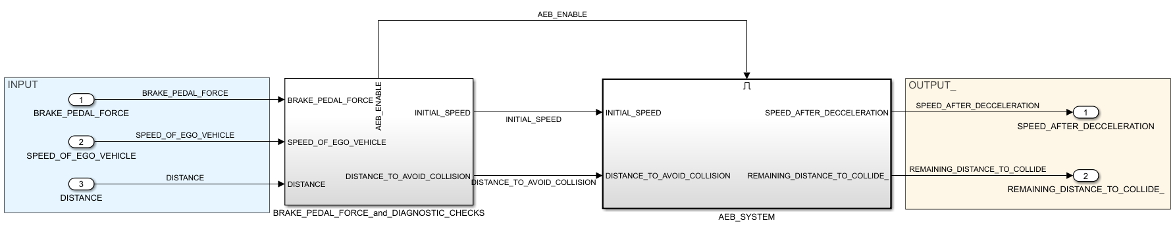
AEB MODELING

Slide 11
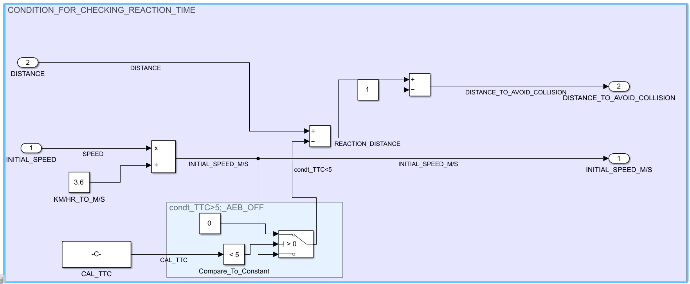
TTC CALCULATION & REACTION TIME CONDITION
In this subsystem the speed of the ego vehicle is converted from Kmph to m/s. The TTC is calculated according to the initial speed and distance. Then the TTC is compared. If the TTC is less than 5s there will be no reaction time. If the TTC is equal to 5s then there will be a reaction time (1s) given to the driver.

Slide 12
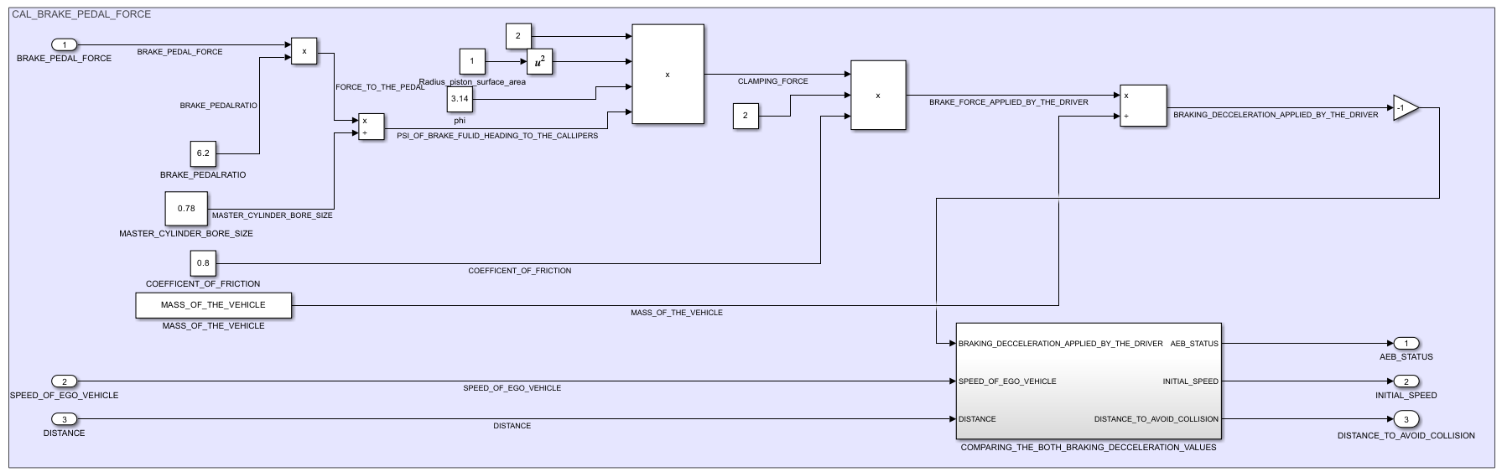
BRAKE PEDAL FORCE CALCULATION
The braking deceleration applied by the driver is calculated from brake pedal force, brake pedal ratio, master cylinder bore size , mass of the vehicle, clamping force and brake force.

Slide 13
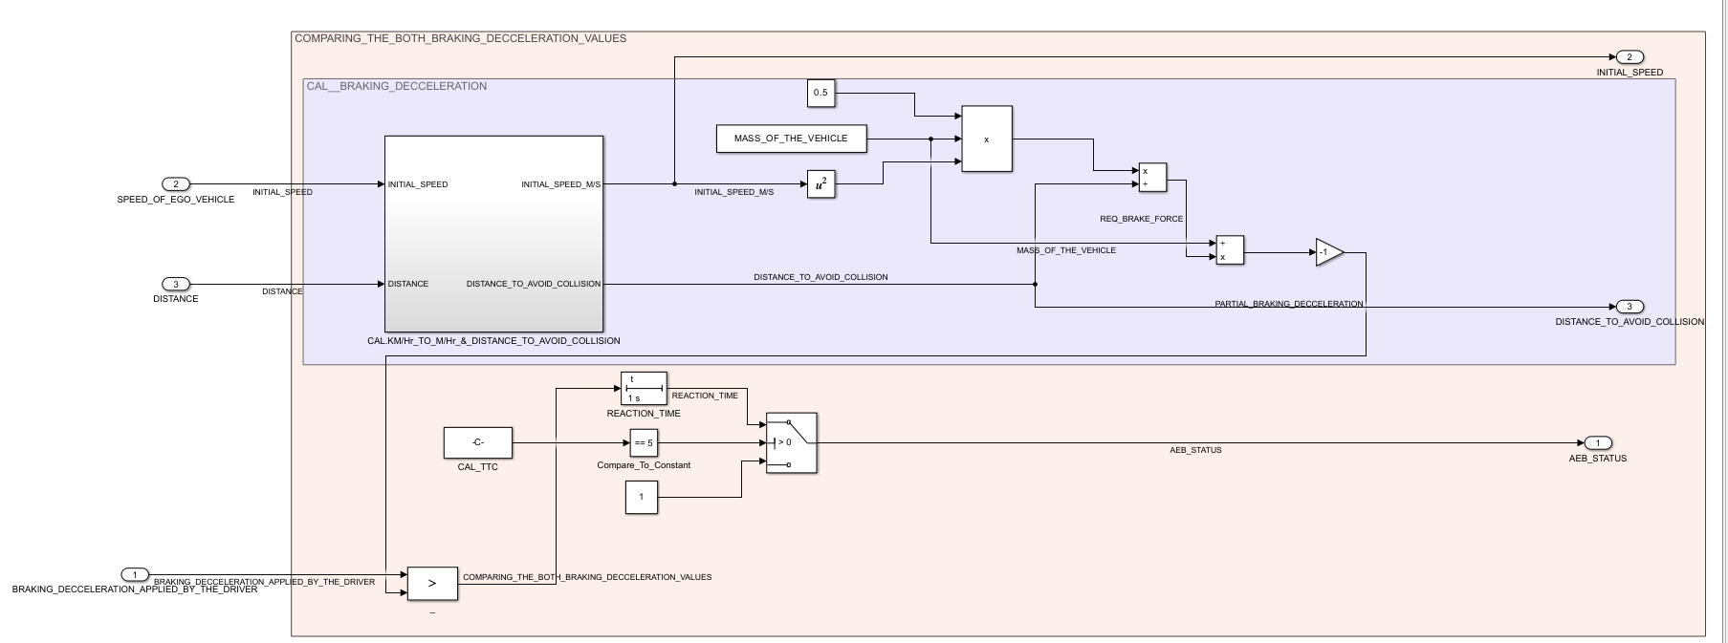
COMPARING BOTH DECELERATION
In this system the braking deceleration is compared with the required deceleration within the reaction time. If the deceleration applied by the driver is sufficient then AEB will remain in off state else the AEB will be enabled after the reaction time

Slide 14
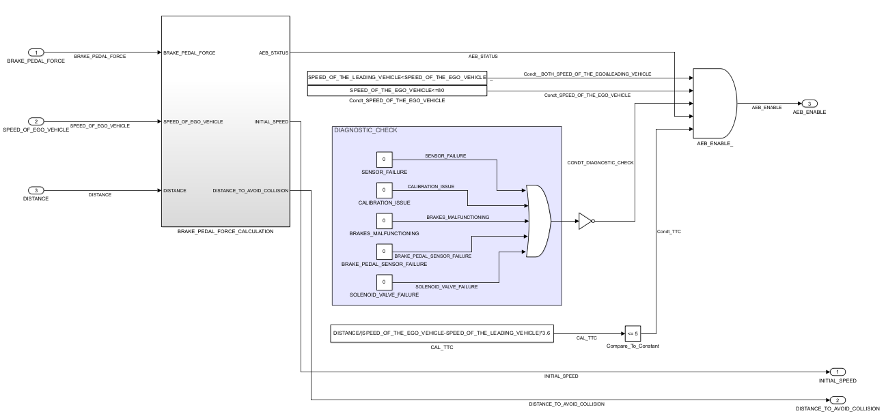
AEB ENABLE CONDITIONS
There are many chances for fault so considering all these factors the AEB will be enabled or disabled. If the fault occurs then the fault warning will be shown in the dashboard.
BRAKE_PEDAL_FORCE&
DIAGNOSTIC_CHECKS

Slide 15
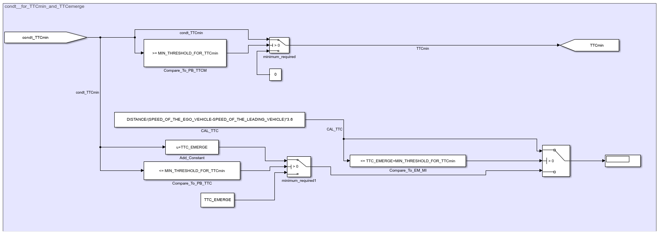
CONDITION FOR TTCmin and TTCemerg
We had given Minimum threshold value for TTCmin. If there is insufficient time for TTCmin there will be a chance of collision so minimum threshold for the TTCmin is required
If TTCmin is less than or equal to MIN_THRESHOLD_FOR_TTCmin our system directly applies full brake according to the distance between two vehicles ( in this case TTCemerg=TTCmin+TTC)
If TTCmin is greater than MIN_THRESHOLD_FOR_TTCmin there will not be any risk of collision.

Slide 16
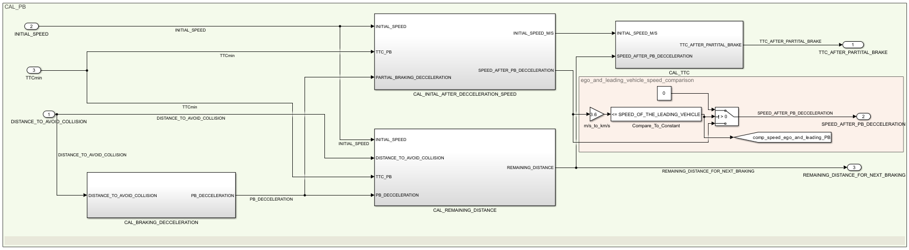
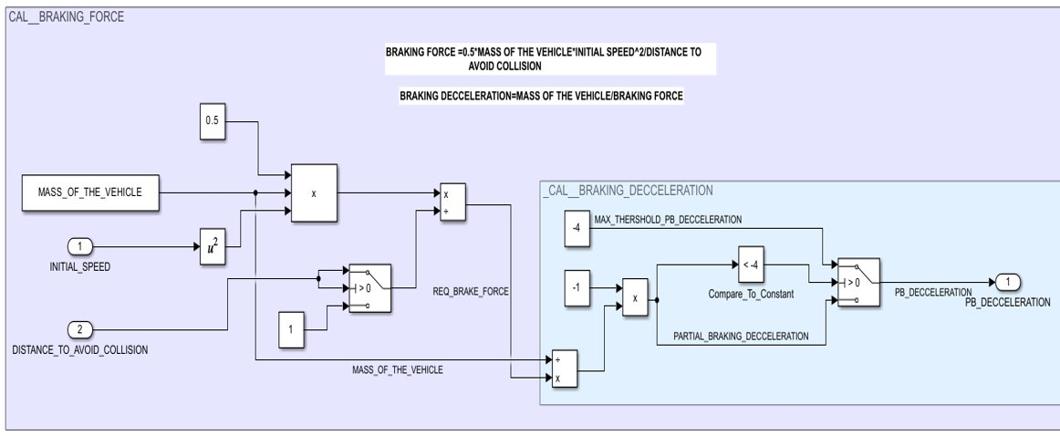
PARTIAL BRAKE CALCULATIONS
In this block calculating TTC after partial brake , speed after partial brake deceleration and Remaining distance. In our system the maximum deceleration for partial braking limited to -4 m/s^2

Slide 17
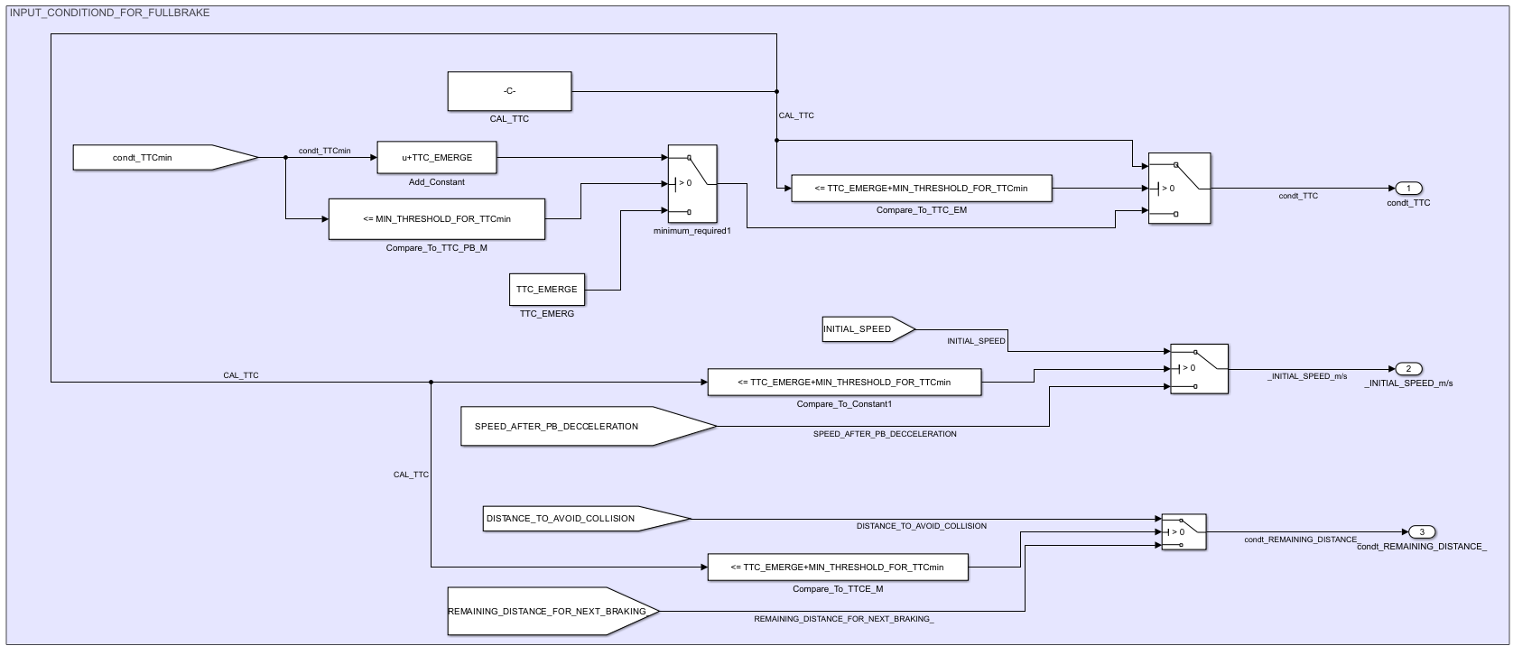
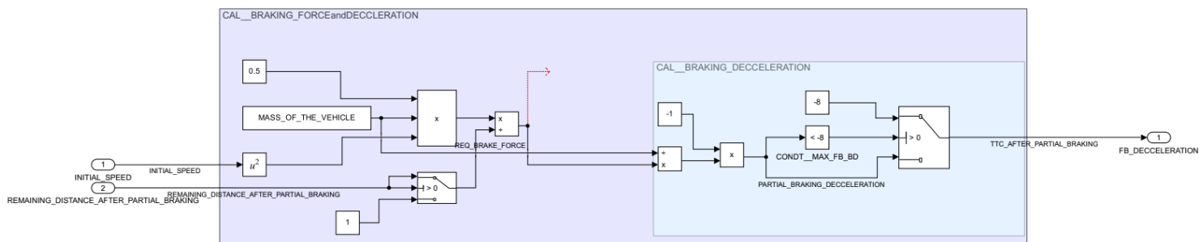
INPUT CONDITION FOR FULL BRAKEING
This block decides the input for full braking. In our system the maximum deceleration for partial braking limited to -8 m/s^2

Slide 18
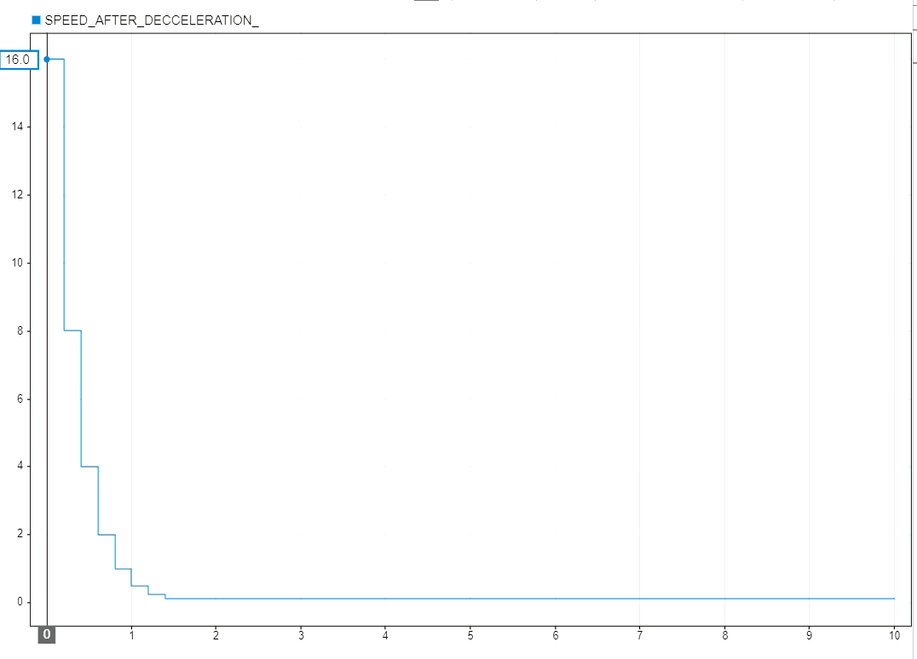
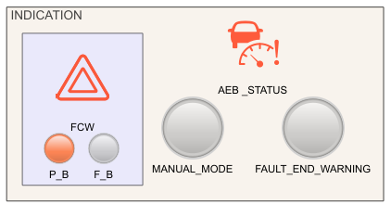
OUTPUT
The graph results the speed of the vehicle has been decreased according to the AEB system.
INDICATIONS:
FCW_on - TTC <=5
MANUAL_MODE_on - if sufficient braking deceleration and if there is fault.
FAULT_AND_WARNING_on - if any fault occurs
AEB_STATUS_on – untill speed of ego vehicle <= speed of the leading vehicle
P_B_on – when partial braking
F_B_on – when full braking

Slide 19
TESTING
Unit testing focuses on testing individual units of model in isolation.
It helps identify and fix bugs early in the development process.
Good test coverage increases confidence in the model’s correctness.
Unit tests act as documentation and aid in debugging and collaboration.
In our system, The unit testing is been followed and tested by different parameters depending upon the conditional statements
The parameters such as Speed of both vehicle ,TTC, TTCmin, TTCemerg, Drivers_braking_force and Required_Braking_force were much needed to test each conditions.
The result of each unit testing results to the output phases(Warning phase/Partial Breaking/Full Braking)

Slide 20

REPORT
SYSTEM DESIGN REPORT – Design process and implementation of system
MODEL ADVISOR REPORT – Analyse and improve quality & efficiency
SIMULINK MODEL REPORT

Slide 21
FUTURE SCOPE
Development of advanced AEB model in MATLAB - Modelling of radar sensor with ECU - Frequency modulated continuous wave.
Integration of LKA (Lane keep assist) - When ego vehicle tends to change the lane.
Capability of autonomously adjusting the vehicle's steering angle or trajectory – To avoid collisions by making steering adjustments when braking alone is insufficient.
Implementation of different modes - Manual mode - High way – Street mode

Slide 22

THANK YOU

